Slide 1
Minimizing Empty Truck Miles Driven via Decision-Theoretic Online Learning and Link Prediction on a Temporal Delivery Order Graph
Department of Statistics, University of Chicago
April 30th, 2024
Theodora Ko B.S’24, M.S.’24

Slide 2



Table of Contents
Introduction
Link Prediction Algorithm
Decision Threshold
Background
Research Problem
Literature Review
Temporal Random Walk
Jaccard Node Similarity
Dynamic Threshold
Hedge Algorithm
Notes:
Background & Research Statement
Link Prediction Algorithm using Temporal Random Walk & Word2Vec Framework
Dynamic Decision Making per route
Summary & Conclusion

Slide 3
1. Introduction

Slide 4

Empty miles are a problem
Between
20 – 35%
of the total trucking miles driven in the US are empty
Eliminating these
empty miles will save 1.5-2.5% of US GHG emissions, equivalent to transitioning 7-11% of the U.S. national power grid to renewable sources
- Uber Freight 2022
Better information, matching, and scheduling can reduce empty miles!
Better information, matching, and scheduling can reduce empty miles!

Slide 5

Problem Statement
Legend
Filled Order
Day 1
Day 2
New Order
A
A
B
B
D
C
D
C
What new orders will there be?
Should the driver wait until the new order to C is scheduled?

Slide 6
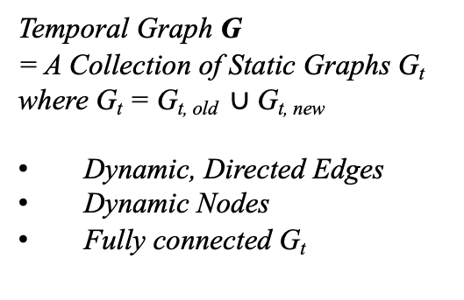


Problem Statement
Legend
Unreachable Node
t-1
t
Current Node
Week
Previous Edge
New Edge
Temporal Graph G
= A Collection of Static Graphs G_{t} where G_{t} = G_{t, old} $∪$ G_{t, new}
Dynamic, Directed Edges
Dynamic Nodes
Fully connected G_{t}
$$⋯$$
$$⋯$$
G_{t-1,first n days of week t}
G_{t-1, ??}
G_{t, first n days of week t}
G_{t, last 7 – n days of week t}
Temporal Link Prediction Problem: For each week t, based on the graph of first 5 days’ order, can we compute the probabilities of new edges existing in the graph of the last 2 days?
Decision Problem: Based on the computed probability of existence, can we compute a decision threshold to minimize total delivery cost?
Notes:
As you can expect, then this can be translated into a link prediction & statistical decision theoretic problem
Given a temporal graph G, or a collection of static graphs that change over some time interval,

Slide 7
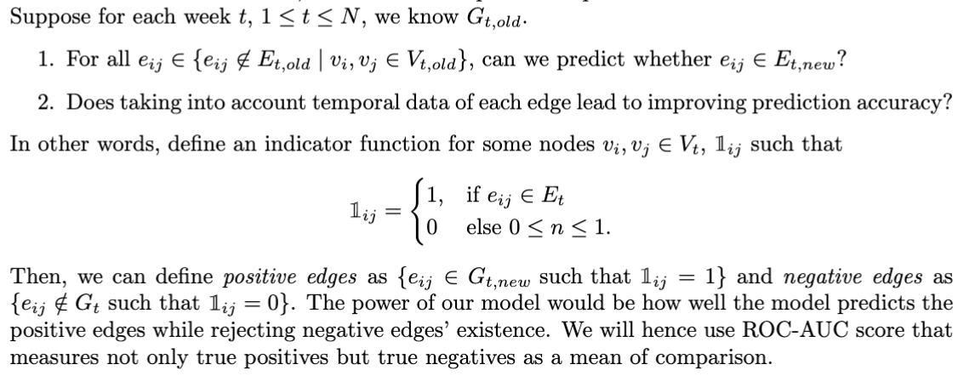
Problem Statement
Temporal Link Prediction Problem
Notes:
Typo v_t old
Else typo
Roc auc

Slide 8
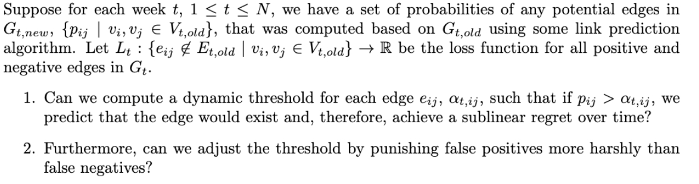
Problem Statement
Decision Problem

Slide 9

Data & Constraints
No known covariates for delivery order → Embedding framework
No attributes for each location → node feature learning algorithm
Interpretability → no black box models, no deep learning
Supervised learning & Immediate feedback
Cold Storage & Warehouse Company
Date scheduled, delivery origin & destination
136 weeks: Jan 1st, 2021 – Jun 1st, 2023
Geographical granularity:
Zipcode (zip3) level: ?? Nodes, ?? edges
Key Market Area (KMA) level: 135 nodes, ?? edges
Notes:
Nodes do not have attributes associated with them, edges have attributes → need to come up with an algorithm to “learn” the attributes of the nodes
No distance information
No black box models more interpretability --> no neural networks
Time varying graph
Directed edge prediction
Exploration of application of the thought data structure and expandability

Slide 10
Review of Relevant Literature
Static & Temporal link prediction algorithms
DeepWalk: Online Learning of Social Representations; Perozzi et al. 2014
Continuous-Time Dynamic Network Embeddings; Nguyen et al. 2018
NodeSim: node similarity based network embedding for diverse link prediction; Saxena et al. 2021
Temporal Link Prediction: A Unified Framework, Taxonomy, and Review; Qin et al. 2022
Online learning & Expert Problems
A decision-theoretic generalization of on-line learning and an application to boosting; Freund et al. 1997
The Multiplicative Weights Update Method: a Meta Algorithm and Applications; Arora et al. 2012
Introduction to Online Convex Optimization; Elad Hazan, 2019
Notes:
Supervised learning & immediate feedback
Available graph link prediction algorithms often focus on nodes more than edges & look at how similar two nodes are to predict edges

Slide 11
2. Graph Embedding Framework
Q: What node embedding algorithms should we use?
Q: How do we take into account time of each order into the embeddings?

Slide 12
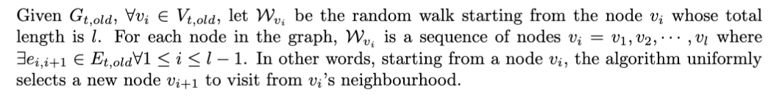
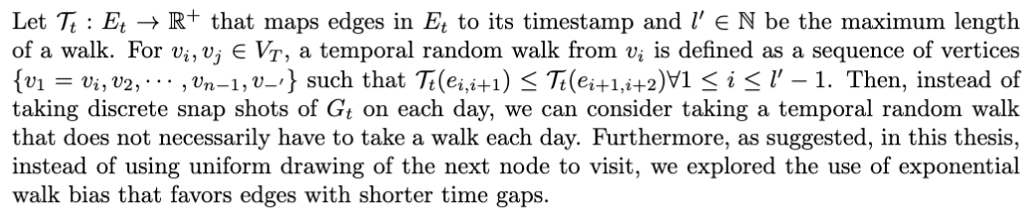
Static v.s. Temporal Random Walk
Static Random Walk
Temporal Random Walk

Slide 13


Static v.s. Temporal Random Walk
Static Random Walk
Temporal Random Walk
Time
1
1
3
$$⋯$$
$$⋯$$
2
2
3
Legend
Unreachable Node
Current Node
Previous Edge
New Edge
Notes:
Motivation: hRandom walks to generate a group of adjacent nodes that are likely to have edges
ow likely is there a walk from u to v based on past historical data?
Taking into account the temporal structure
Neighbor similarity → can’t do this because each node doesn’t have attributes assigned
Based on who’s connected to what neighbourhood
Can we take into account temporal features for nodesim?
CTDNE
CTDNE with static random walk (confirmed better results with trw)
Nodesim vs nodesim w temporal features
Level 1 (TRW: fixed node sets – if no RW, returns 0, CTDNE)
Edge similarity .. ?
time series forecasting
How to take into account further data history?

Slide 14
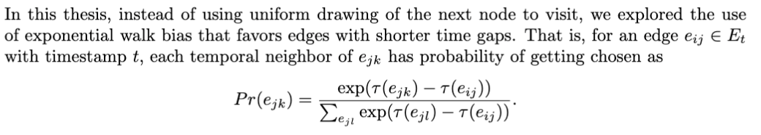
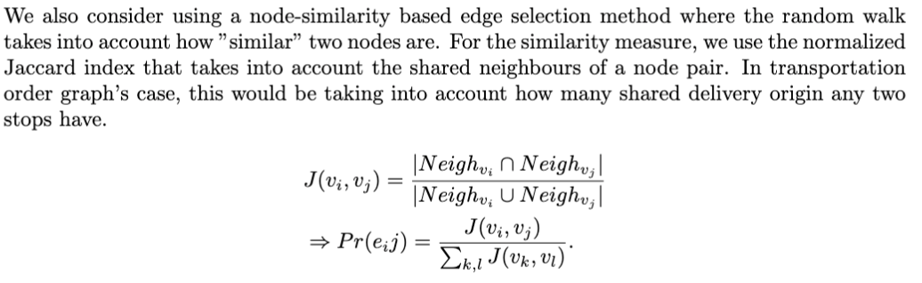
Temporal Random Walk Edge Weighting
Exponential Weighting
Node Similarity Weighting
Notes:
deciding the probabilities of choosing an edge in each step of random walk
Use normalized jaccard index as the

Slide 15
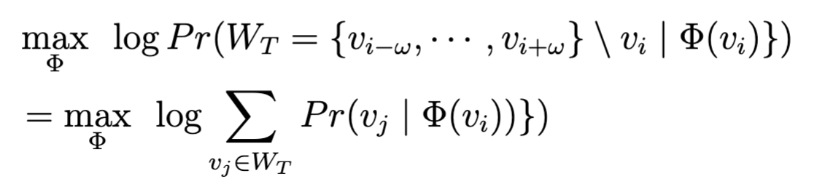
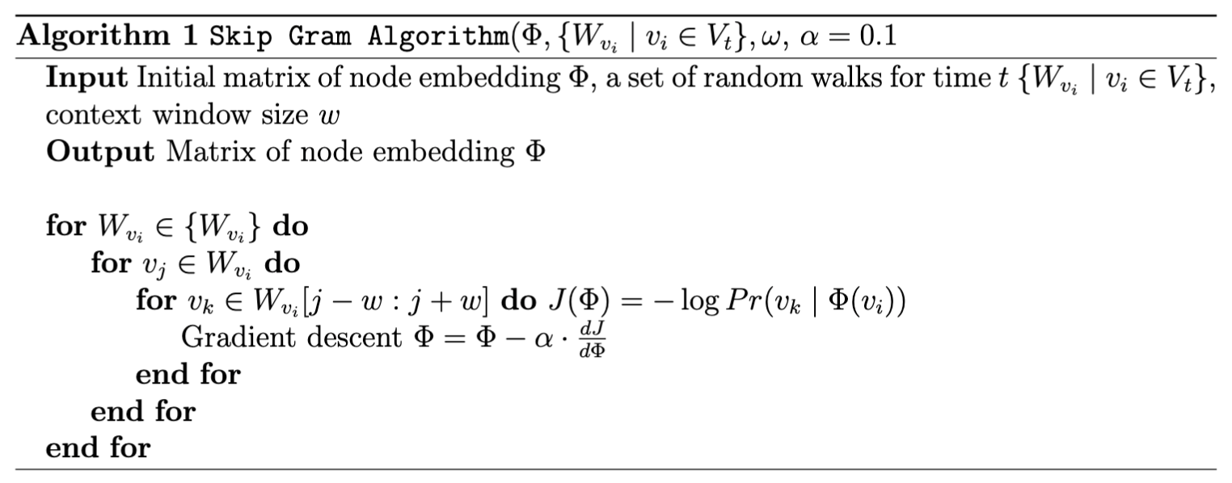
Time-preserving embeddings: SkipGram

Slide 16
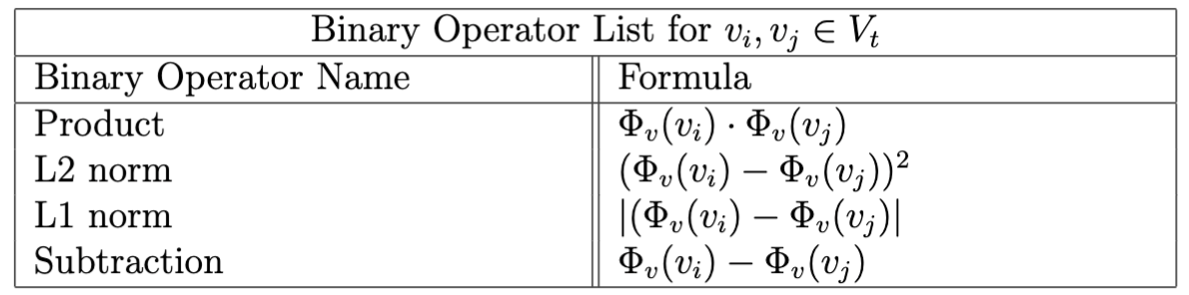
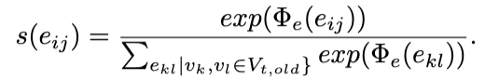



Edge Embedding & Probability Computation
Node Embedding function $Φ$_{t,v} $:V_{t} ⟶ℝ^{l′}$
Edge Embedding function $Φ$_{t,E} $: \{Φ\text{t}\text{,}\text{v}{(v}_{i}),Φ\text{t}\text{,}\text{v}{(v}_{j}) |{ v}_{i}, v_{j}∈V_{t}\} ⟶ℝ$
Softmax function $s$_{t} $: \{Φ\text{t}\text{,}\text{E}{(e}_{i,j}) | v_{i}, v_{j} ∈V_{t}\} ⟶[0,1]$
Notes:
Edge embedding to account for directionality

Slide 17
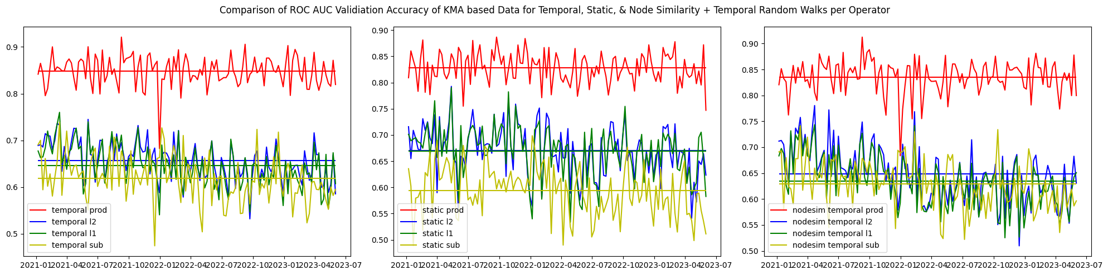
Simulation Result on KMA Level Data
Notes:
ROC AUC
Training & Testing Error
Static vs Temporal Random Walk
Using operator L1 vs Subtraction
Other static link prediction algorithms
Other graph embedding algorithms
Parameter tuning
Different operators (l2, l1, prod, sub)

Slide 18
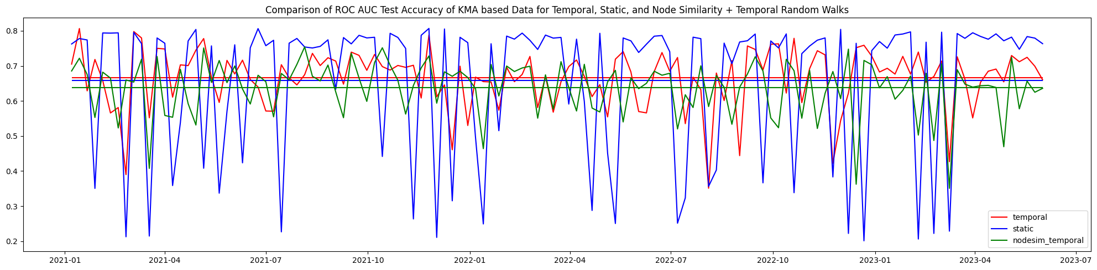
Simulation Result on KMA Level Data
Notes:
ROC AUC
Training & Testing Error
Static vs Temporal Random Walk
Using operator L1 vs Subtraction
Other static link prediction algorithms
Other graph embedding algorithms
Parameter tuning
Different operators (l2, l1, prod, sub)

Slide 19
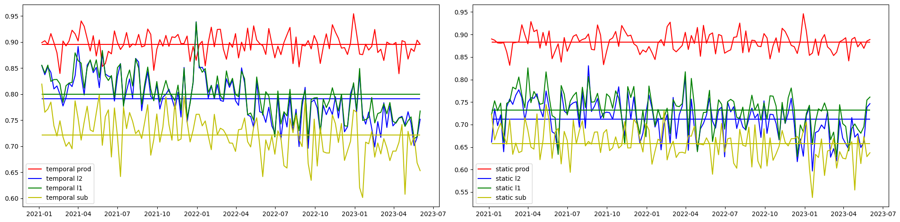
Simulation Result on ZIP3 Level Data
Comparison of ROC AUC Validation Score between Static and Temporal Random Walk

Slide 20
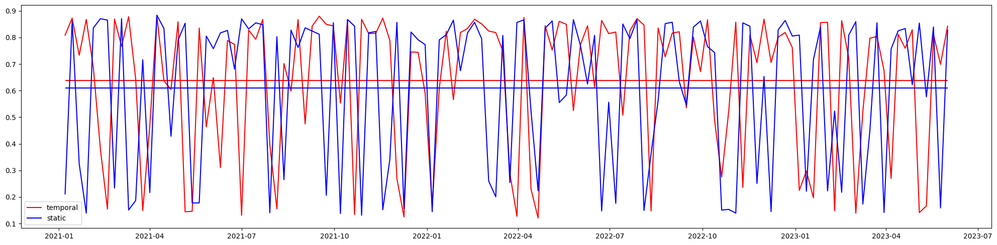
Simulation Result on ZIP3 Level Data
Comparison of ROC AUC Test Score between Static and Temporal Random Walk

Slide 21
Simulation Results Table
Notes:
For KMA, ZIP level
Average test score
Average validation score

Slide 22
3. Decision Making
Q: For each edge, can we compute a decision threshold that is better performing than a naïve 0.5 threshold?
Q: Can we compute a decision threshold that punishes false positive most harshly?

Slide 23
Expert Problem
N Experts with N different thresholds
Action
Waiting until new order is scheduled
Return to the origin empty-handed
Regret: 0 if existence = wait decision else 1
Uniform loss between false positive and false negative of 1
Higher penalty on false positive of 3

Slide 24
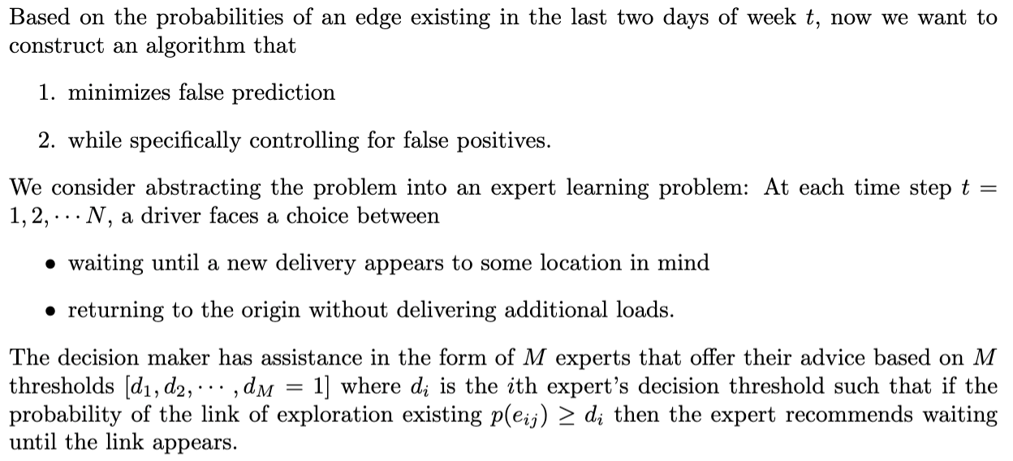
Expert Problem
Notes:
Define Regret!
Regret as decisions made vs reality (immediate feedback)
Hedge Algorithm vs. Naive Algorithm for the entire graph
Regret as ..? (immediate feedback)
Best performing:
temporal random walk + node2vec
Prod operator

Slide 25
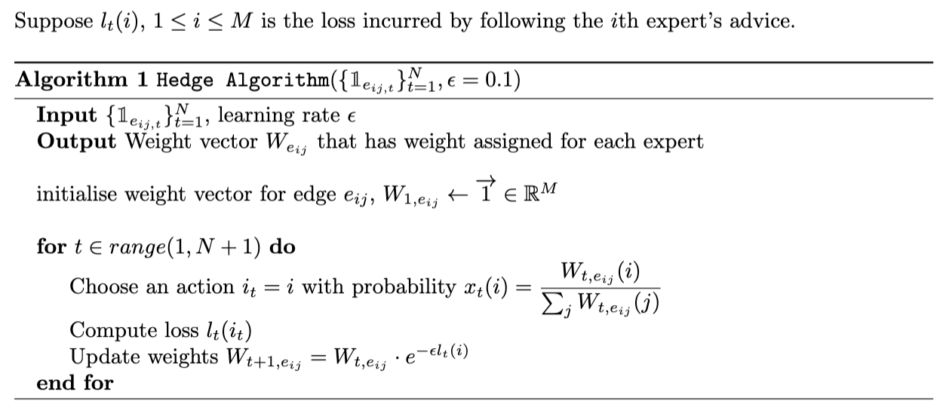
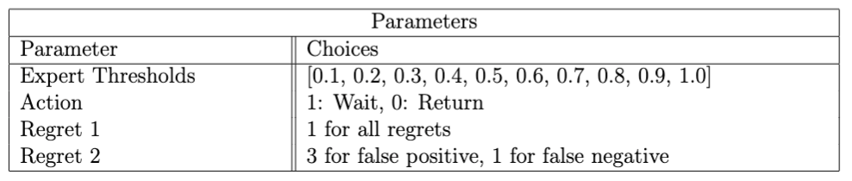
Hedge Algorithm & Design Choices

Slide 26
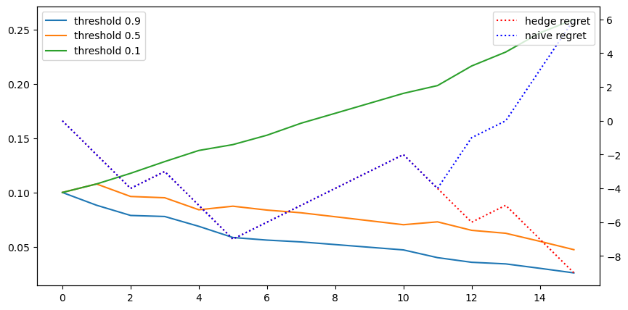
Simulation Result: Sample Route
Change of Weight per Expert v.s. Regret
Weight
Regret
Week
Notes:
Diagram 0: Hedge Algorithm vs. Naive Algorithm for an example route
Diagram 0.5: Weight vector demonstration per expert
Diagram 1: comparison of two lp algorithms (Hedge Algorithm vs. Naive Algorithm )
Diagram 2: treating false positive harshly, while still achieving sublinear regret
Add labels

Slide 27
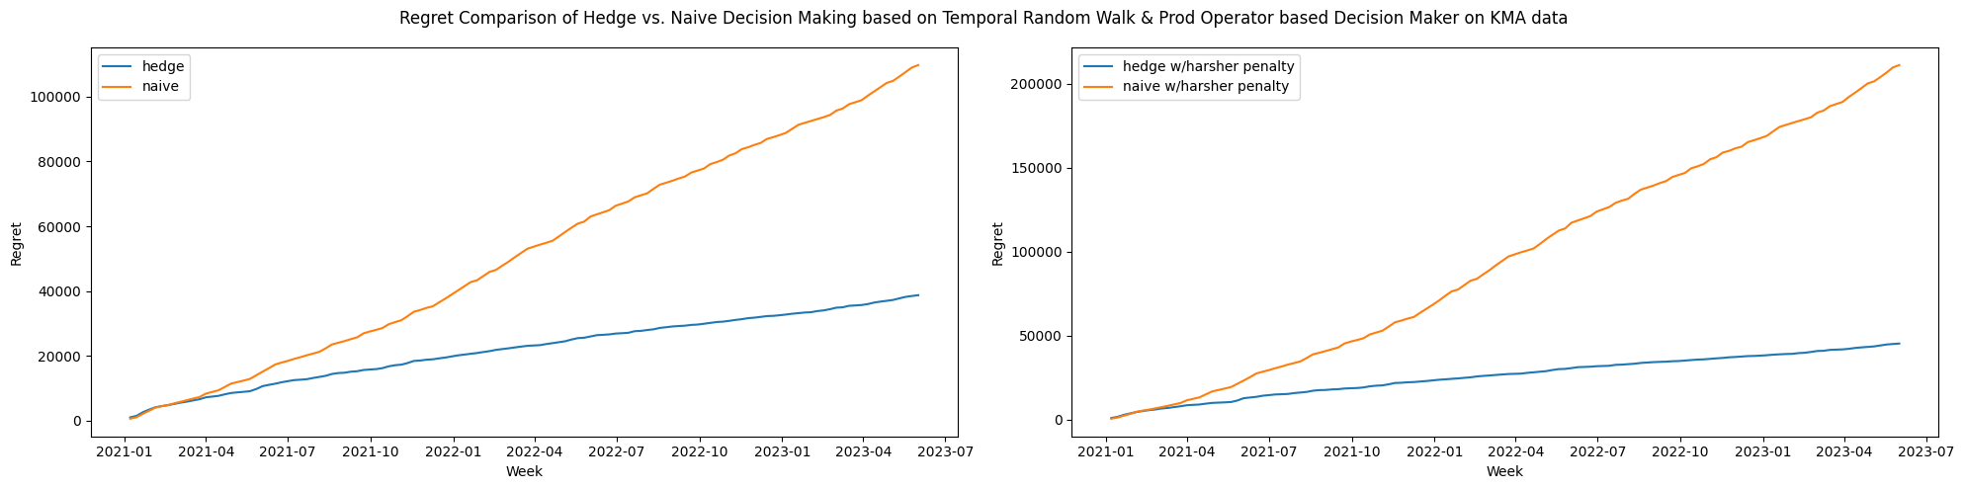
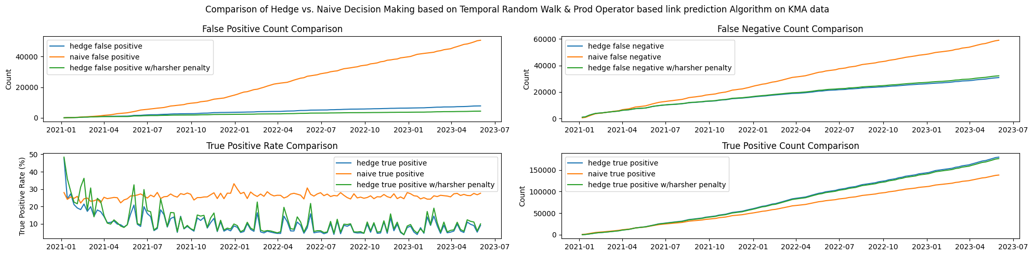
Simulation Result: KMA Level
Notes:
DIFFERENT LEARNING RATES NEED TO BE TAKEN INTO ACCOUNT HERE – ADD DIAGRAMS
Need end numbers!

Slide 28
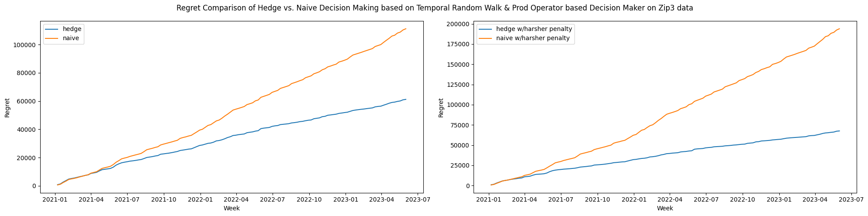
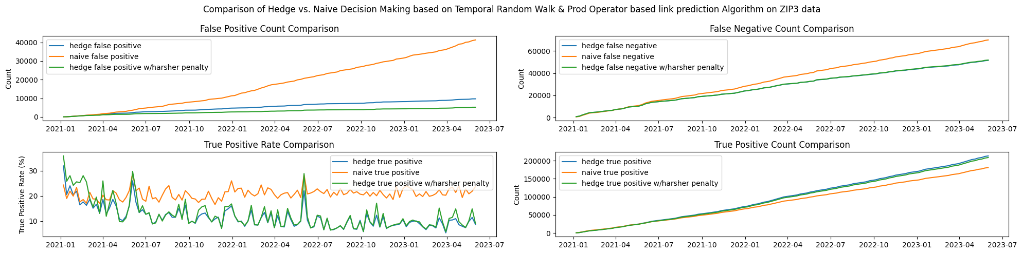
Simulation Result: ZIP3 Level
Notes:
DIFFERENT LEARNING RATES NEED TO BE TAKEN INTO ACCOUNT HERE – ADD DIAGRAMS
Need end numbers!

Slide 29
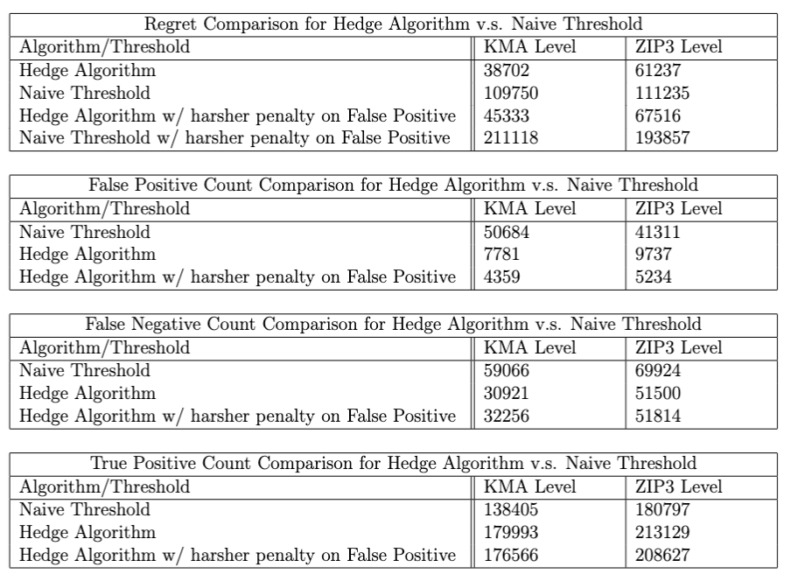
Simulation Results Table
Notes:
For KMA, ZIP level
Regret comparison
False positive, false negative, true positive

Slide 30




Review of Motivating Problem
Given
A driver from Region O to Facility A
A list of possible destination we can reach from Facility A
compute the individual route’s
probability of existing
0.9
Region 01
Region O
Recommended
FACILITY
Attribute 1
0.1
Region 02
ORIGIN
FACILITY A
FACILITY
Attribute 2
0.4
A driver
Region 03
FACILITY
Attribute 3

Slide 31
Conclusion & Summary
Temporal Link Prediction Problem
Best performing node features: Temporal Random Walk
Best performing operator: Product Operator
Skip-Gram Embedding
Decision Problem
Best performing algorithm: Hedge Algorithm
Impose bigger penalty on false positives
Notes:
Add percentages!

Slide 32
Extensions
Multi Graph
Different lookback size (unit: day)
Geographical distance
Hidden Markov Model for latent variable modelling
Notes:
download daily data → construct data for x many days

Slide 33
Thank you!
Professor Cong Ma for his advising
Lineage Logistics LLC. & Data Science Department, Special thanks to Manish, Chloe, and Elliott for supporting me to complete this thesis and the M.S. program
My parents & friends!

Slide 34
Reference
DeepWalk: Online Learning of Social Representations, Perozzi et al. 2014
Continuous-Time Dynamic Network Embeddings, Nguyen et al. 2018
Temporal Link Prediction: A Unified Framework, Taxonomy, and Review; Qin et al. 2022
NodeSim: node similarity based network embedding for diverse link prediction; Saxena et al. 2021
A decision-theoretic generalization of on-line learning and an application to boosting; Freund et al. 1997
The Multiplicative Weights Update Method: a Meta Algorithm and Applications; Arora et al. 2012
Notes:
Supervised learning & immediate feedback
Available graph link prediction algorithms often focus on nodes more than edges & look at how similar two nodes are to predict edges

